Slide 1
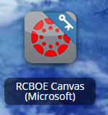
RCSS Learning Platform and Canvas
New to the Richmond County
Go to rcboe.org
Click Student
Click Launch Pad
Watch logging into Canvas as a student.
https://rcboe.instructuremedia.com/embed/048204ea-777e-4c04-9fc0-357111372c96
Your child will login through Launch Pad to access RCBOE Canvas.
Click link to watch Tutorial Video
https://www.rcboe.org/Domain/16265

